Slide 1
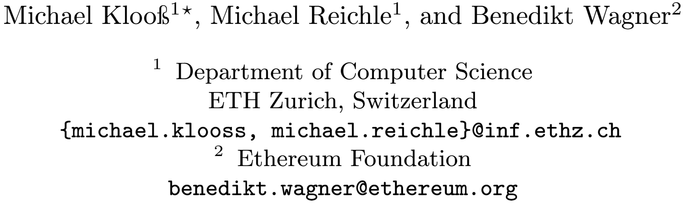
Practical Blind Signatures in Pairing-Free Groups
ASIACRYPT 2024
黄博 2025.3.28

Slide 2
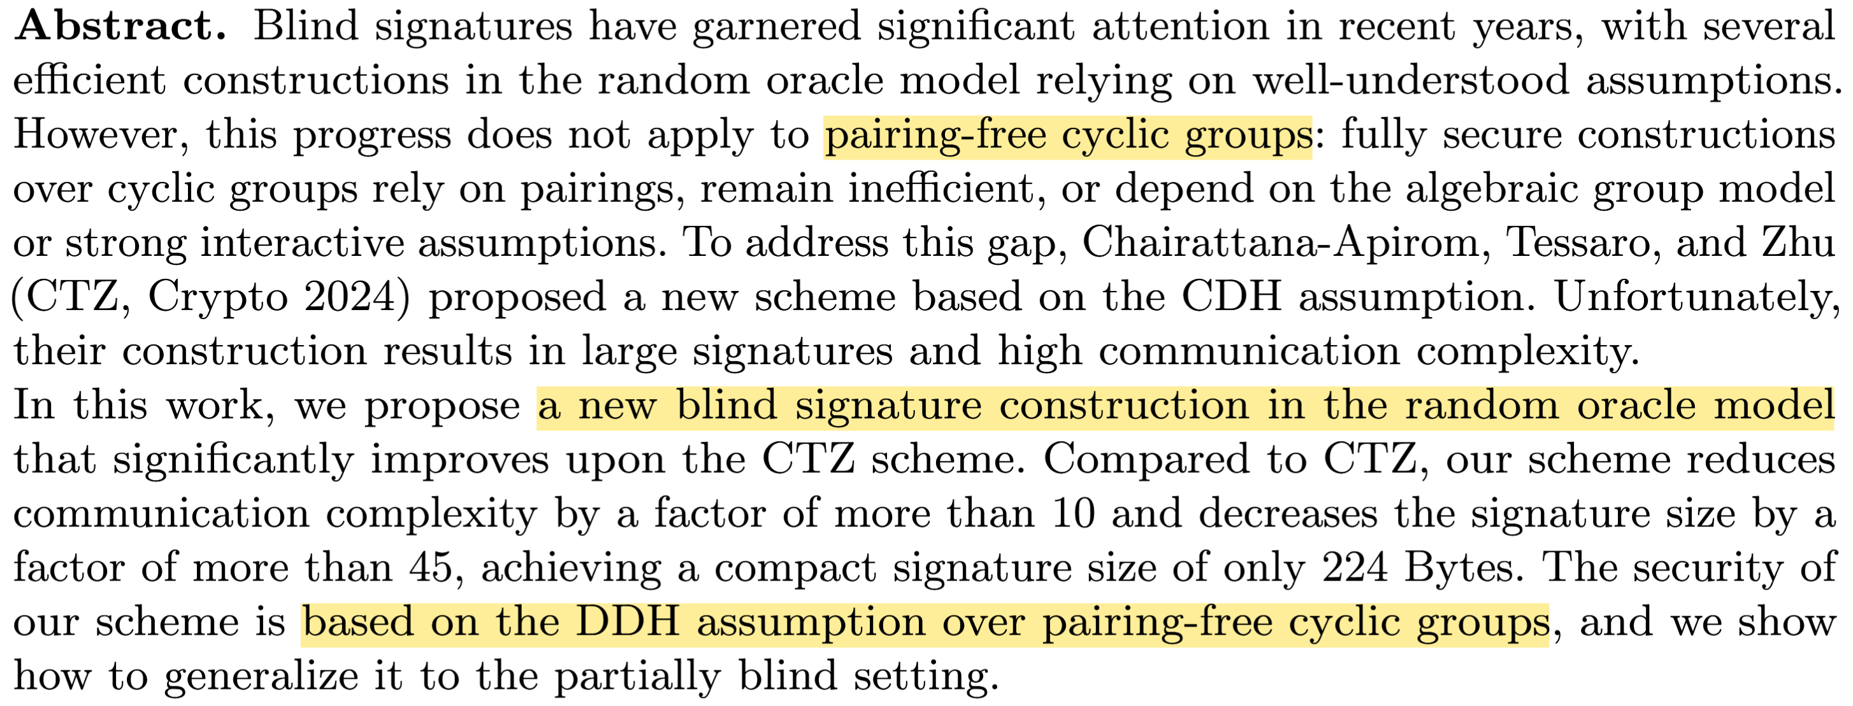
Abstract

Slide 3
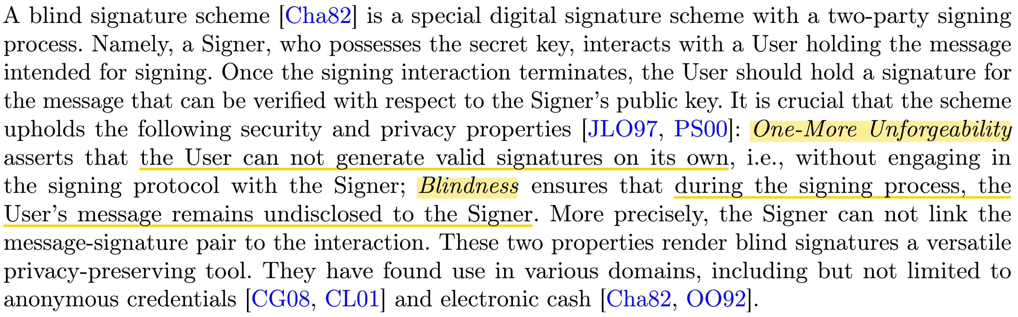
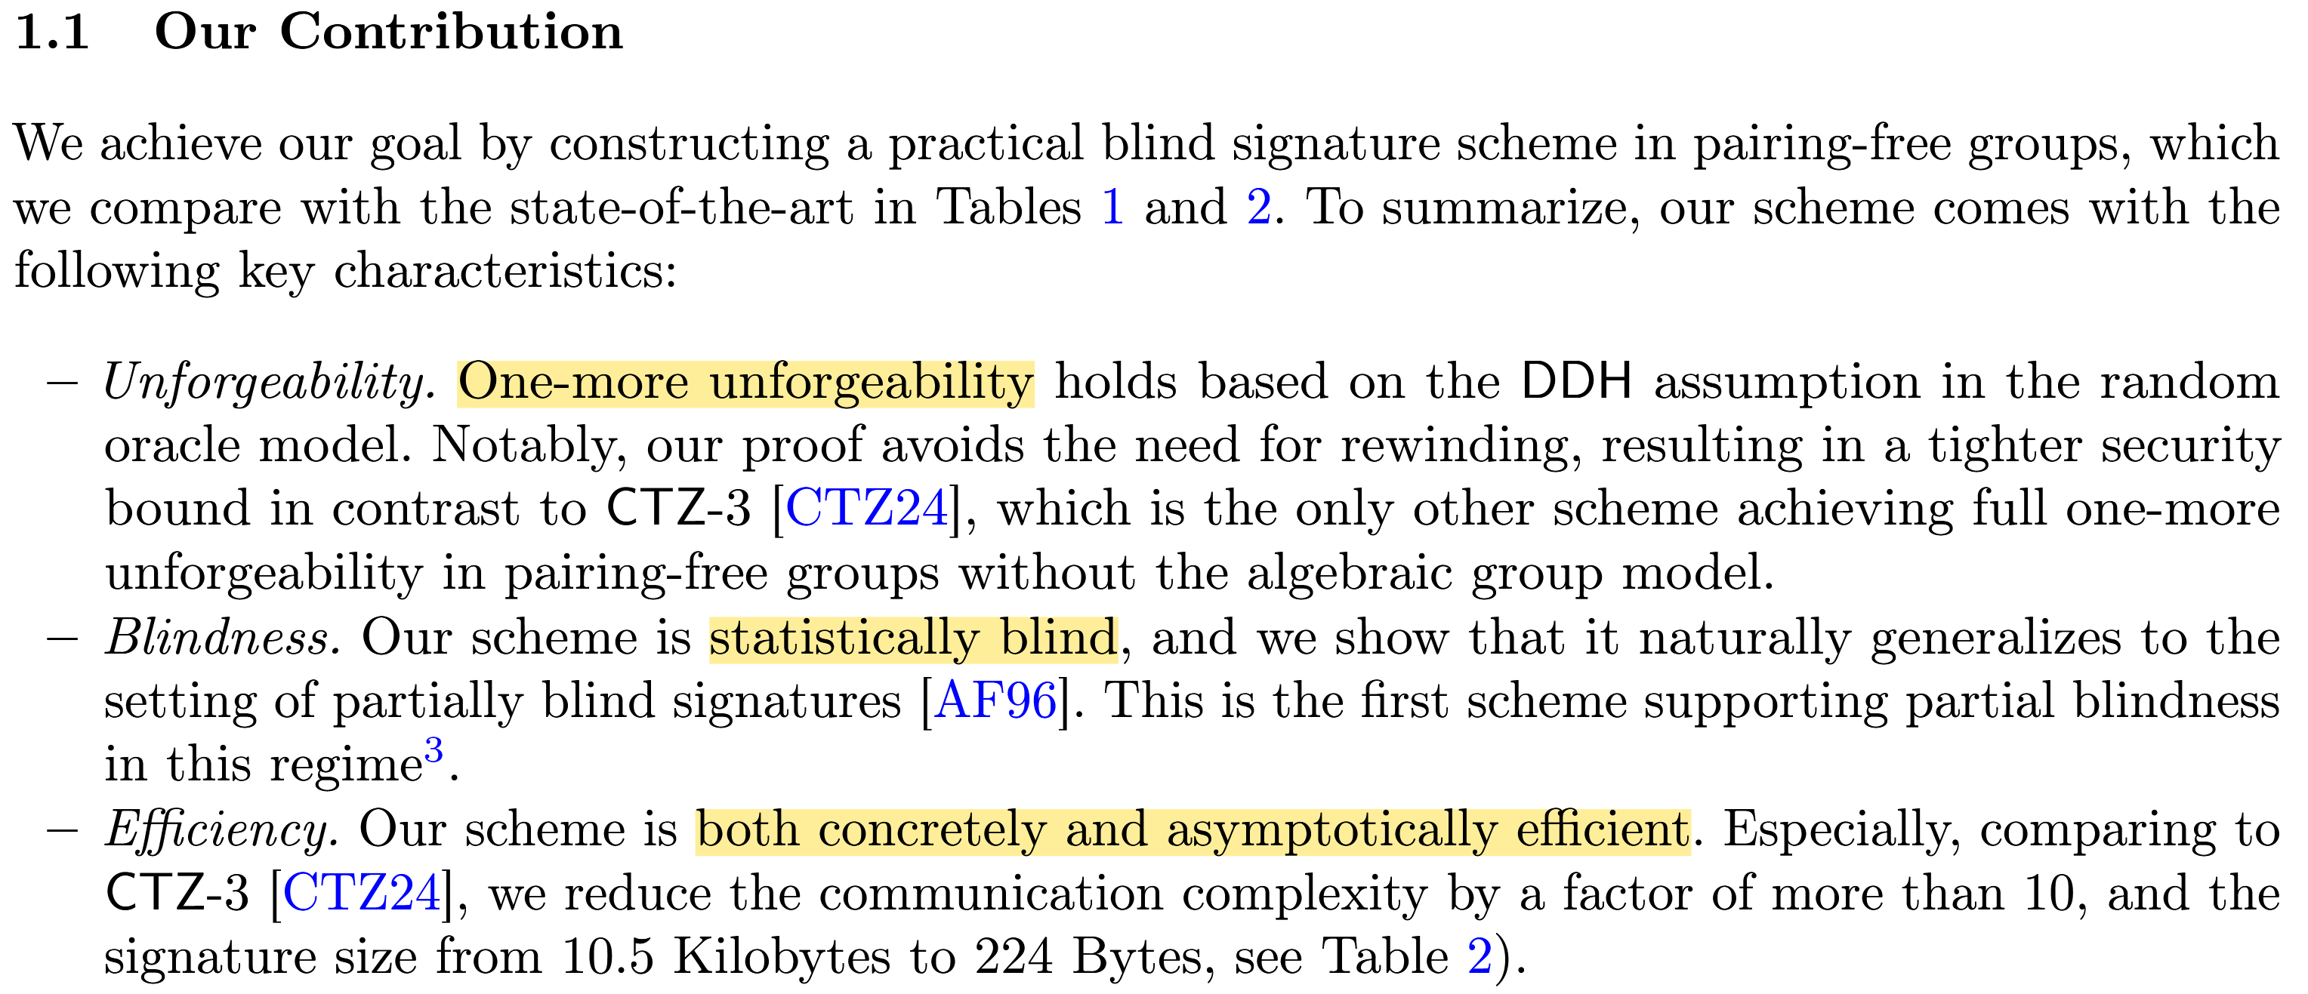
Introduction

Slide 4
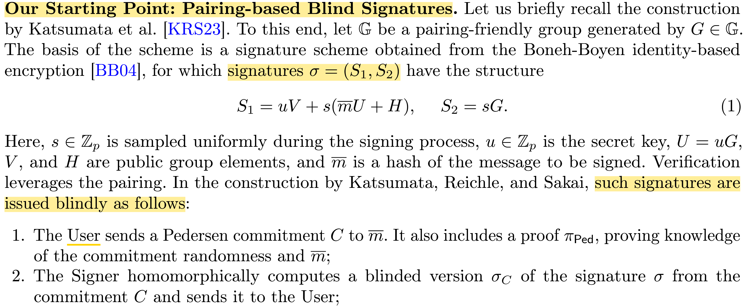
Overview
基于一个双线性对盲签名方案

Slide 5
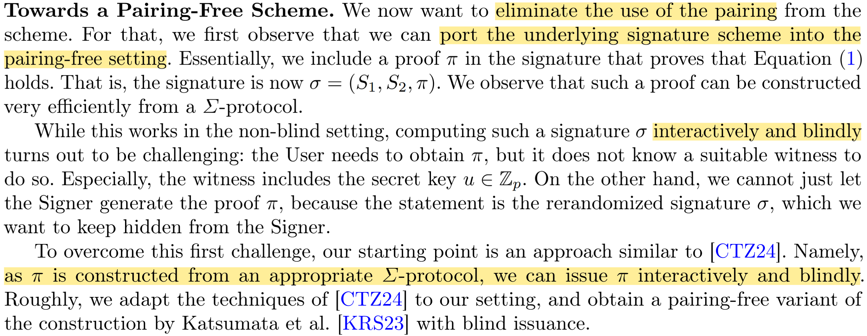
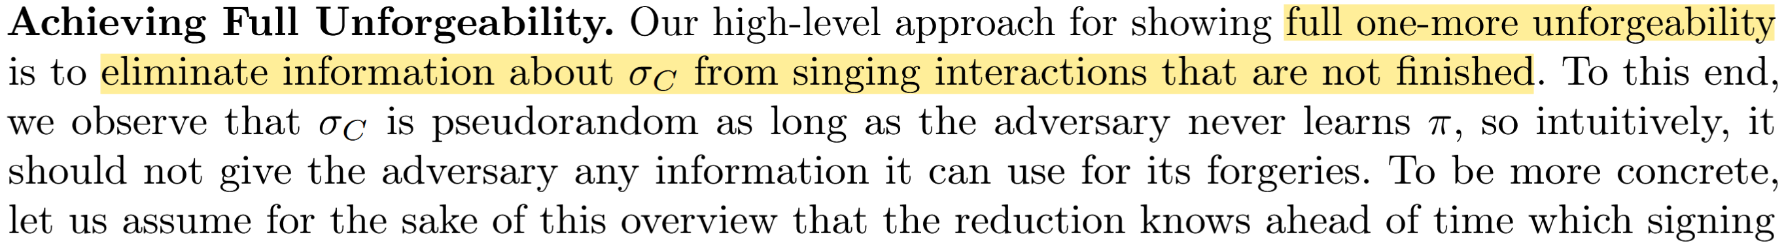
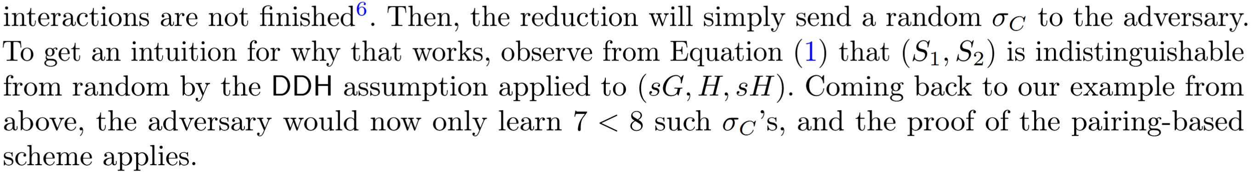
Overview
通过用非交互式证明替换双线性对运算以去除双线性对
在未完成的签名交互中隐藏$σ_{C}$的信息以达到full one-more unforgeability

Slide 6
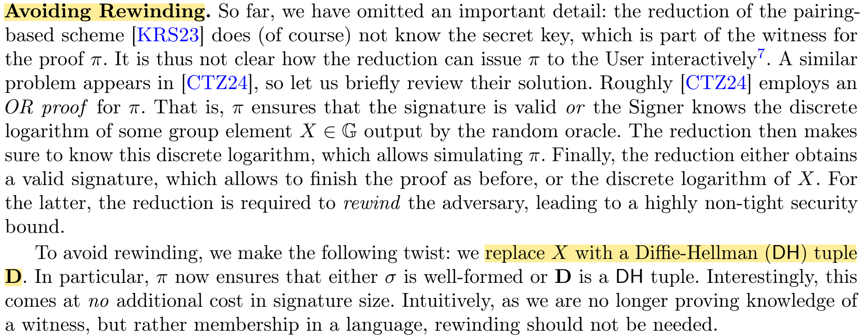
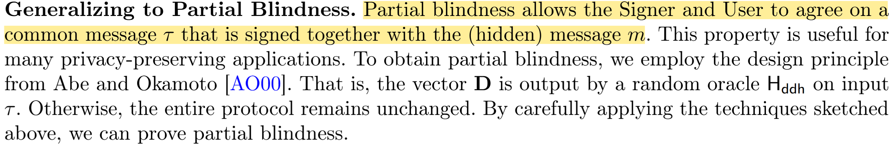
Overview
将证明结构调整为基于Diffie-Hellman（DH）元组以避免rewinding
扩展至部分盲签名

Slide 7
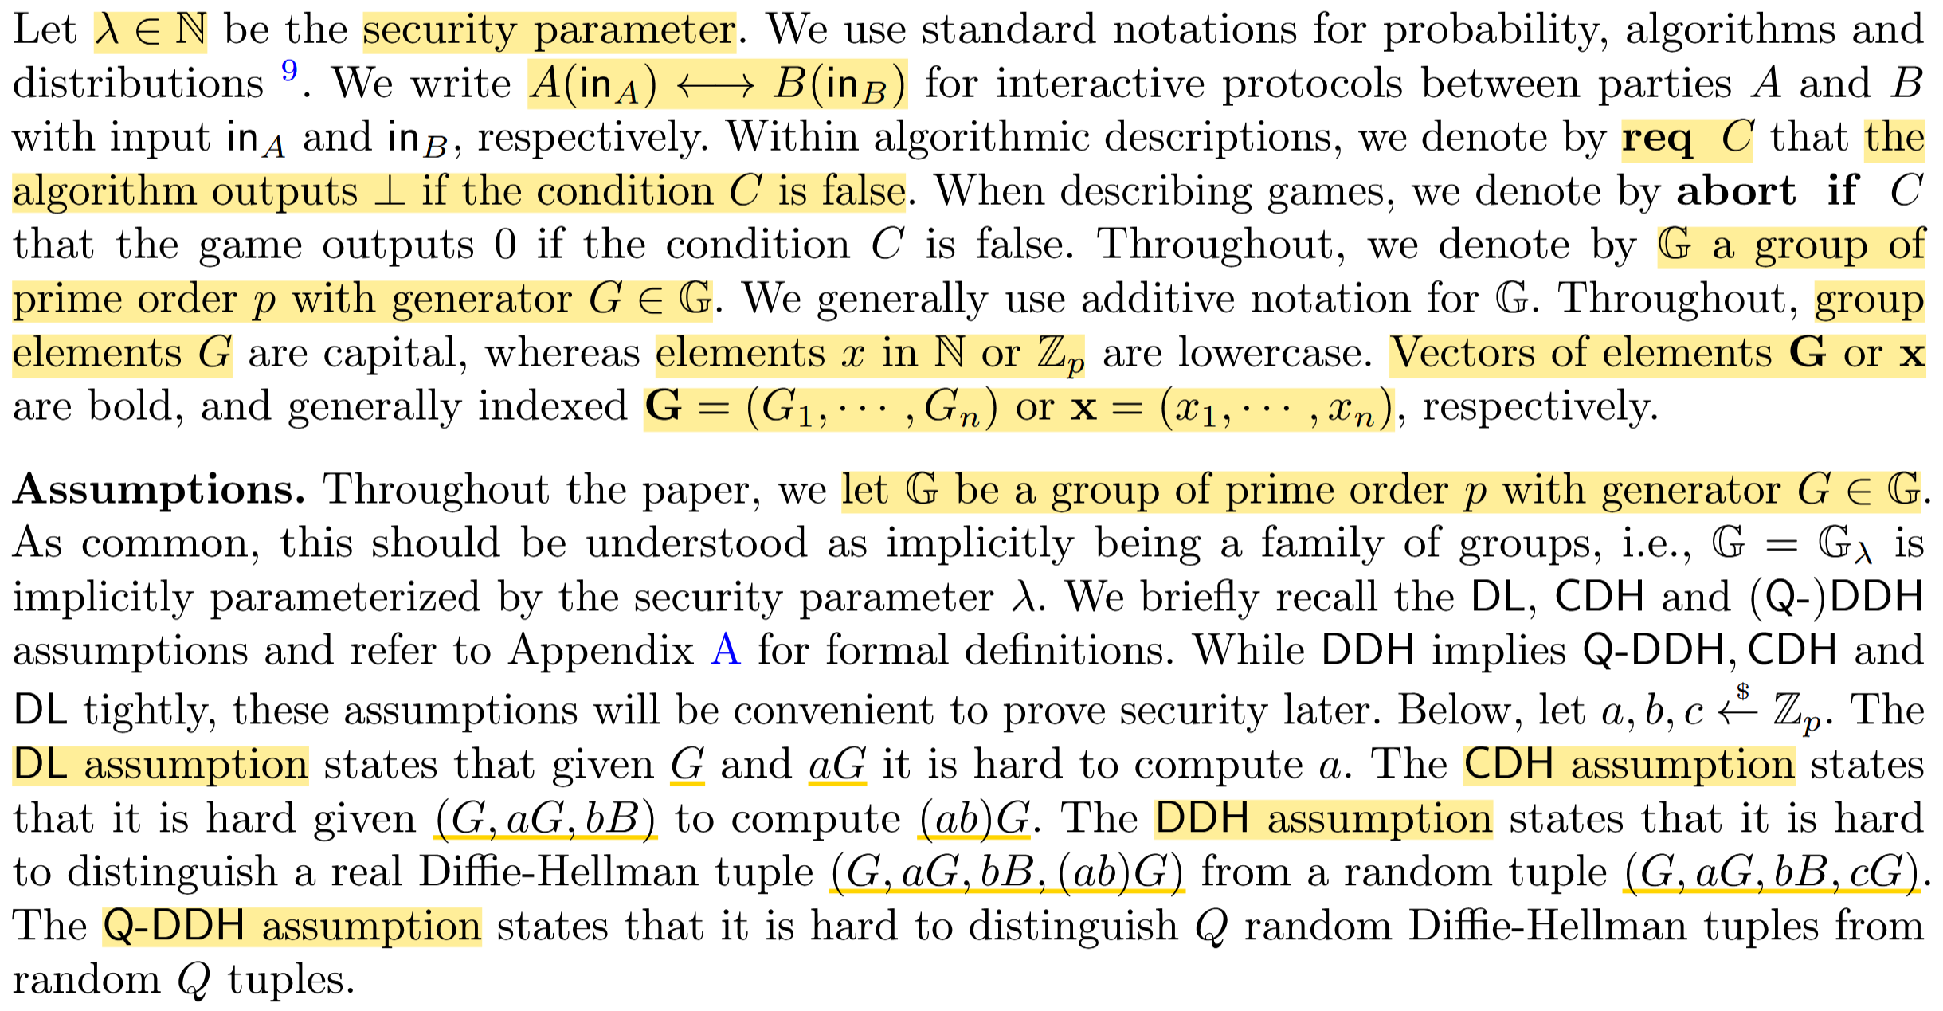
Preliminaries
符号
假设
DL假设
CDH假设
DDH假设
Q-DDH假设

Slide 8
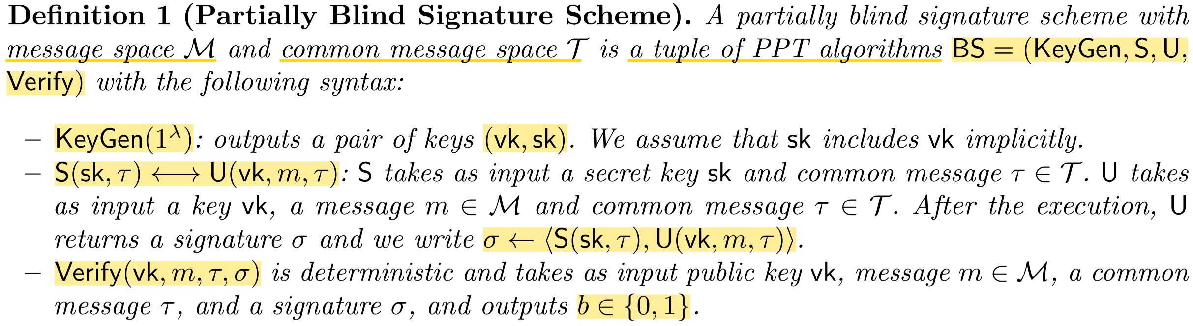
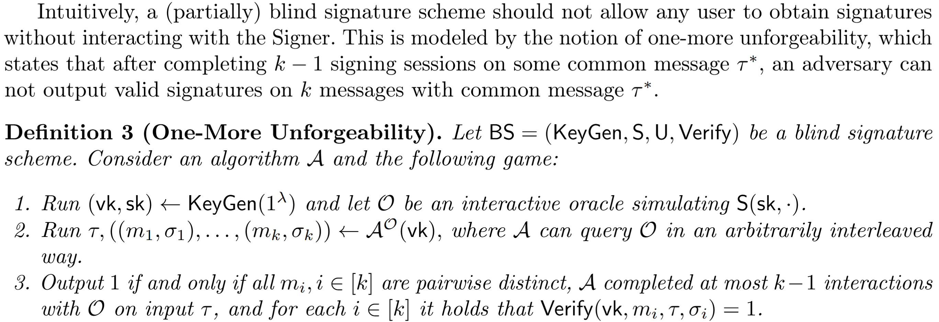
Preliminaries
部分盲签名方案
一次更多不可伪造性

Slide 9
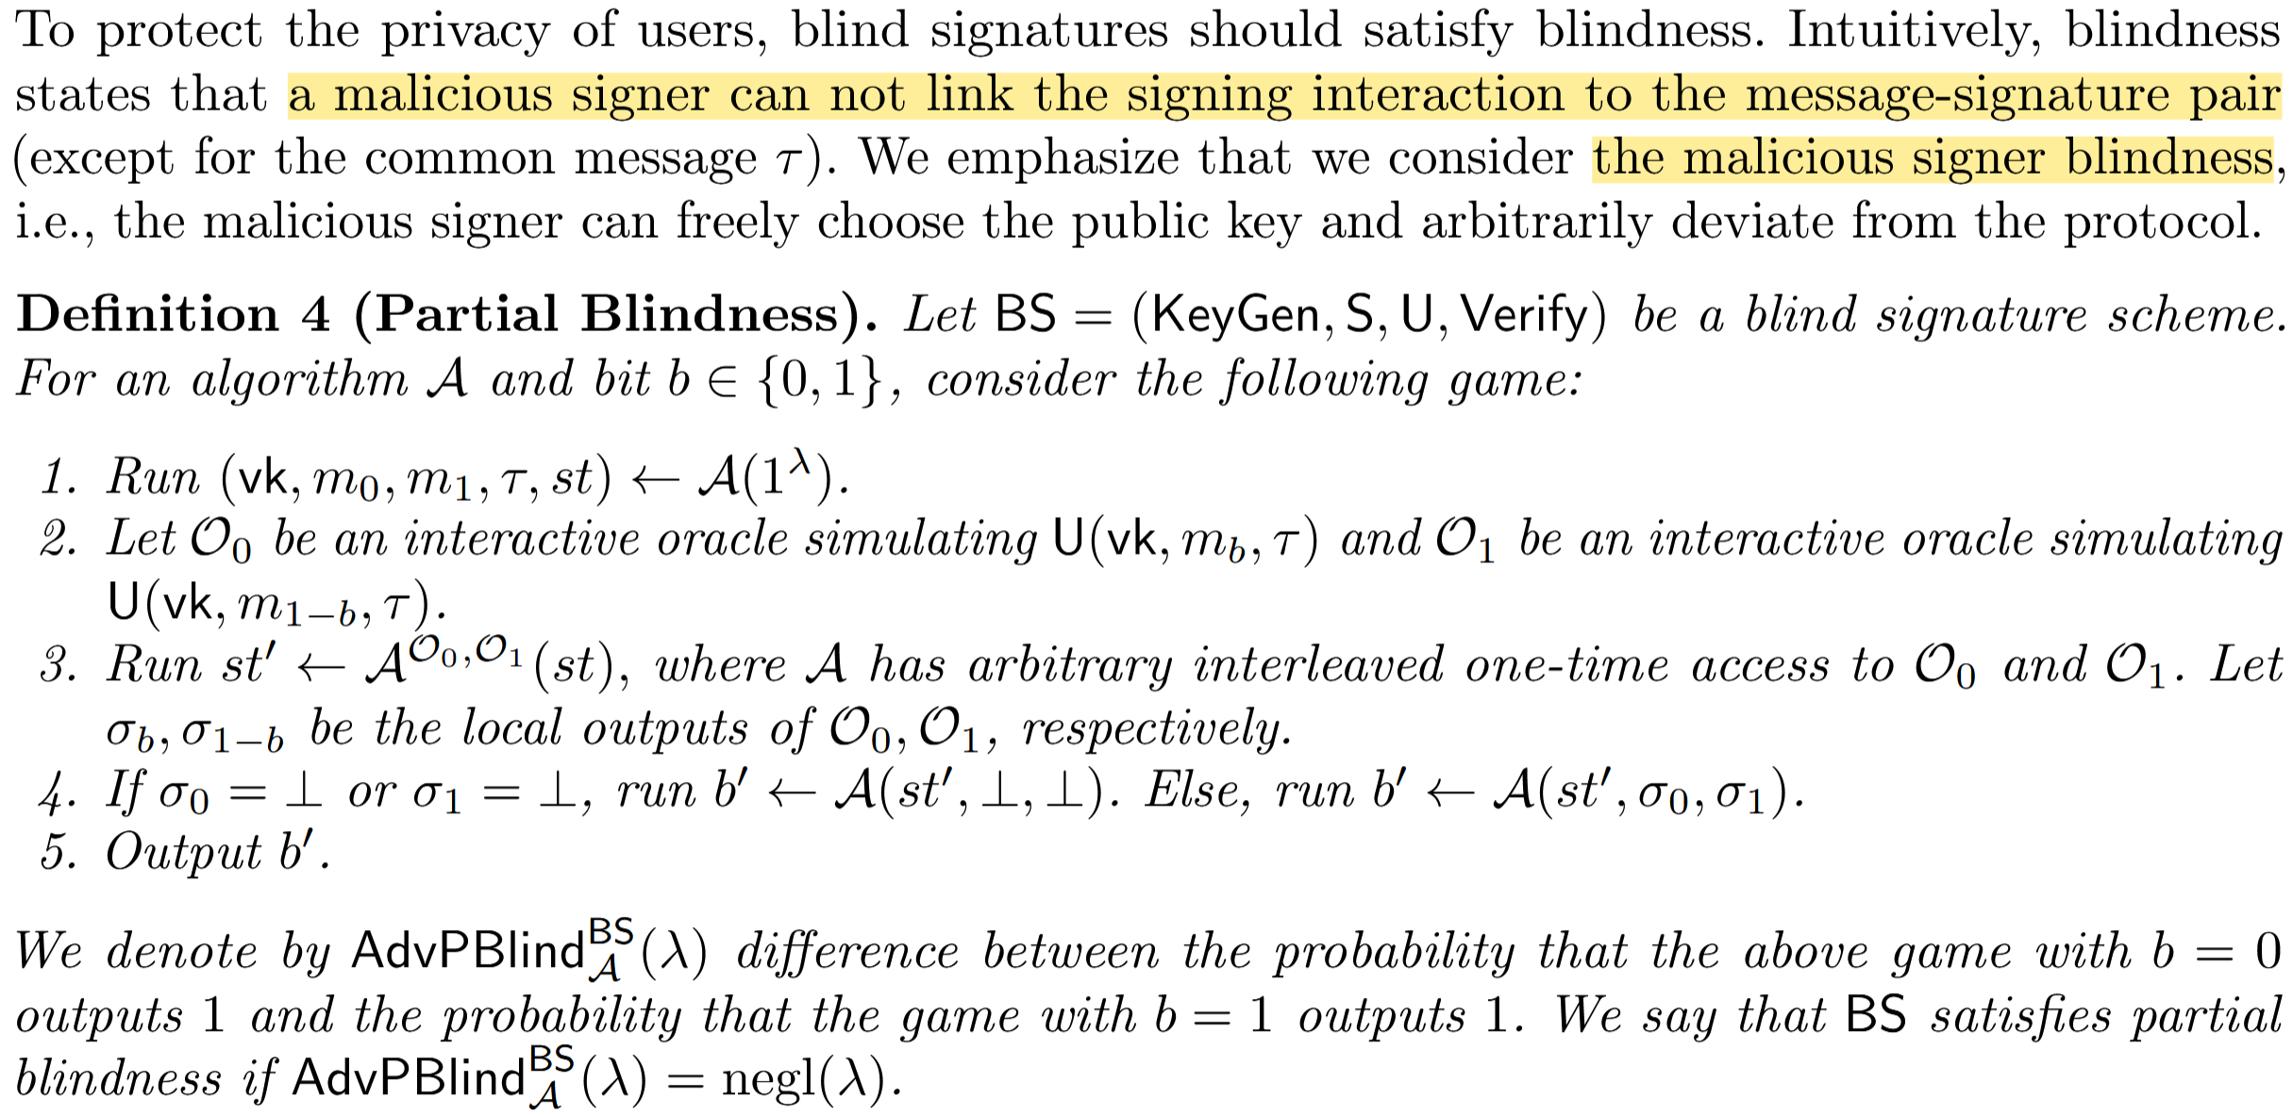
Preliminaries
部分盲性

Slide 10
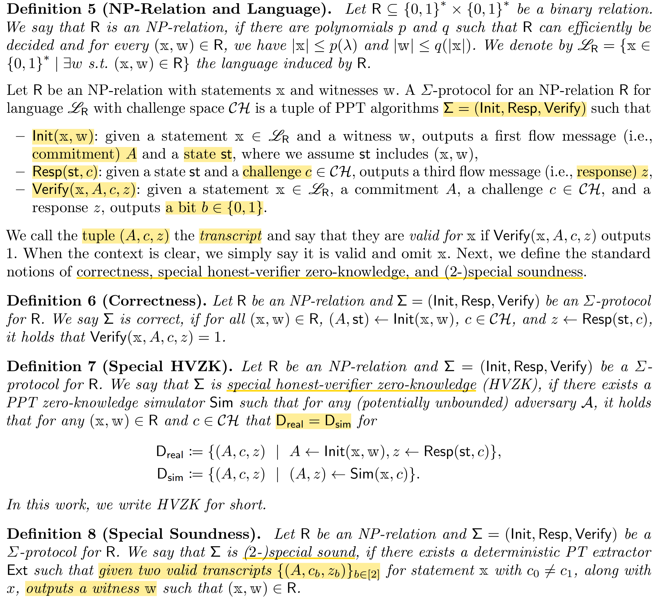
Preliminaries
NP-Relation
Σ协议
(A, st)
z
b

Slide 11
Preliminaries
Correctness
Special honest-verifier zero-knowledge
(2-)special soundness

Slide 12
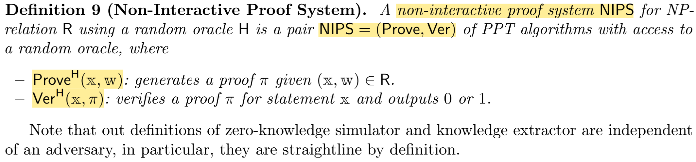
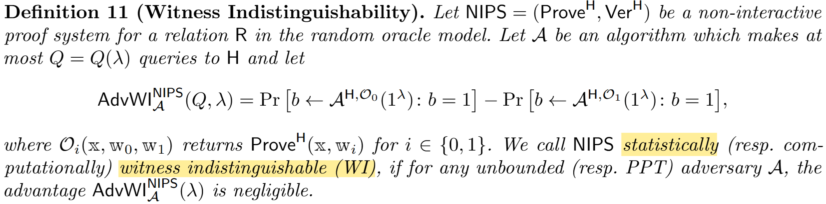
Preliminaries
NIPS
WI

Slide 13
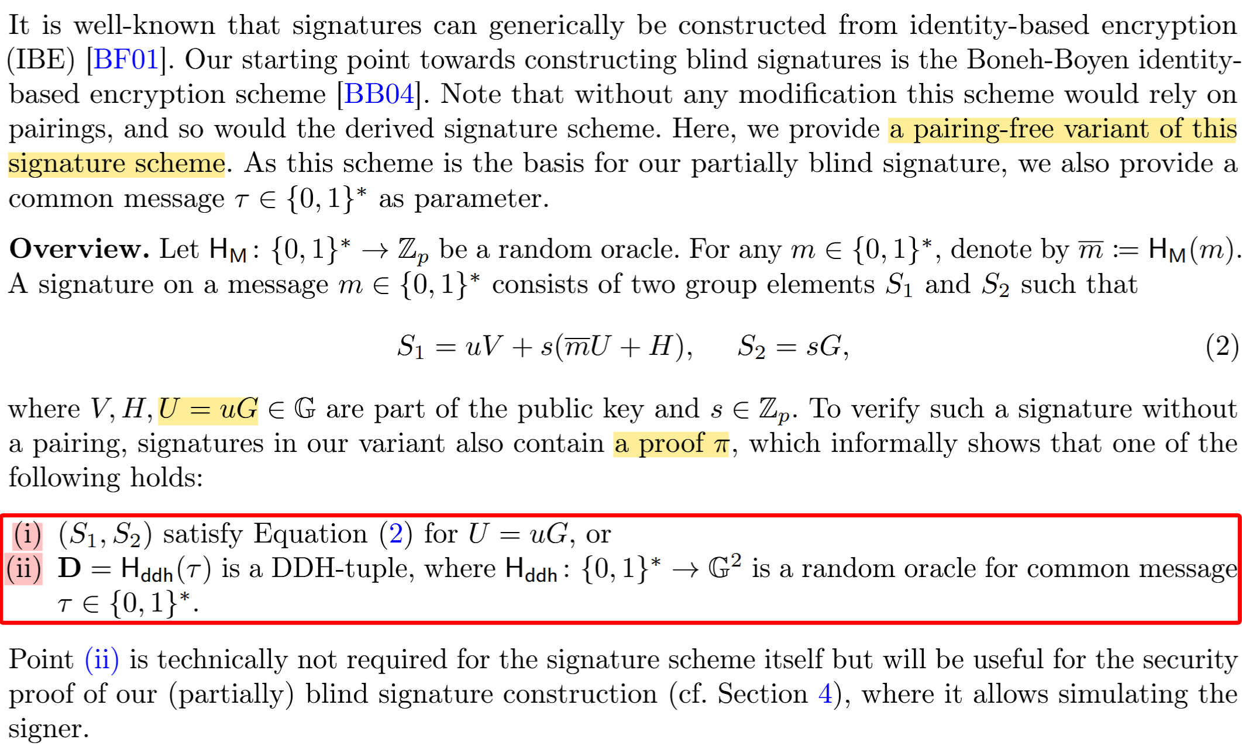
BBSig: Pairing-free signature based on Boneh-Boyen IBE
OR proof
S1和S2是有效的签名
D是一个DDH元组

Slide 14
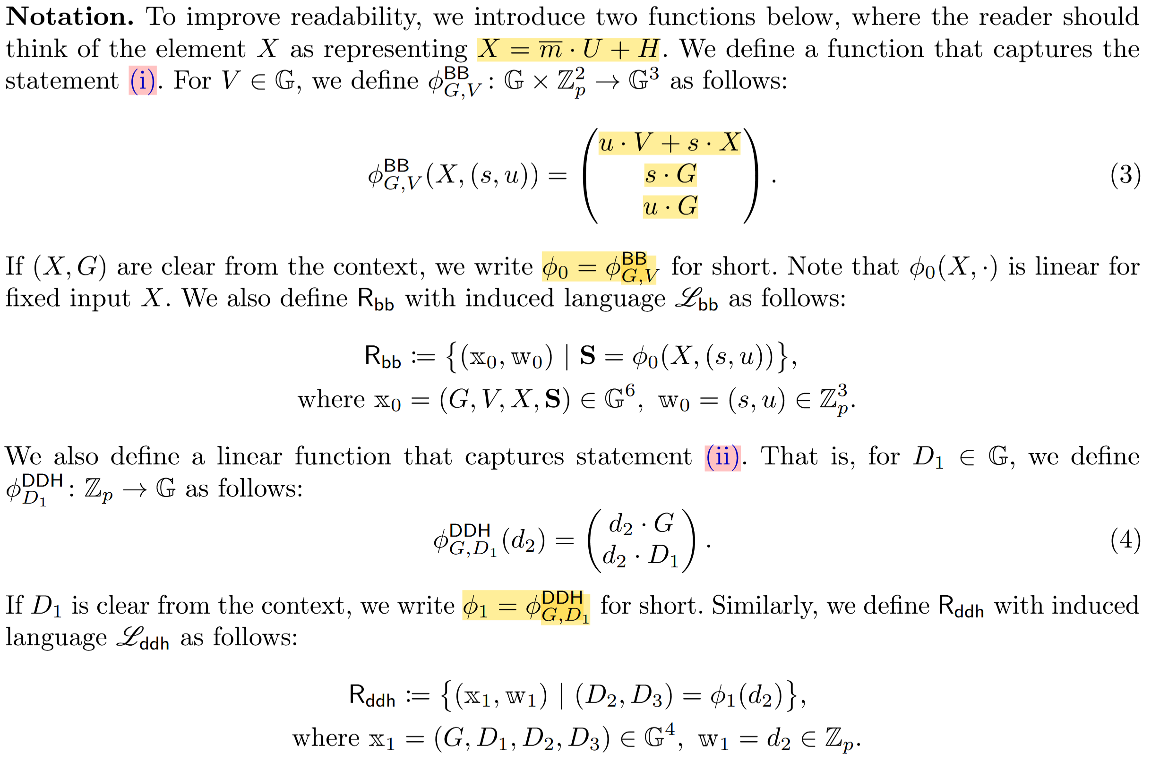
BBSig: Pairing-free signature based on Boneh-Boyen IBE
S1
S2
U
D2
D3

Slide 15
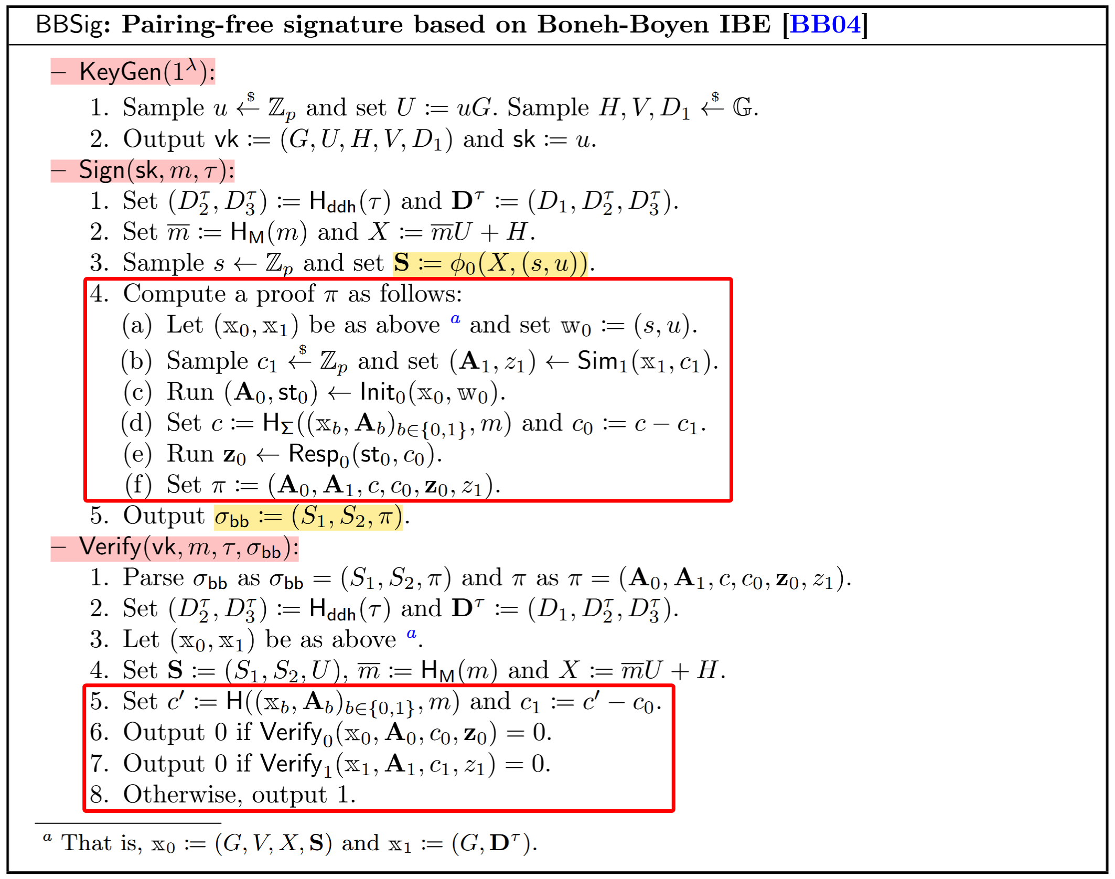
BBSig: Pairing-free signature based on Boneh-Boyen IBE

Slide 16
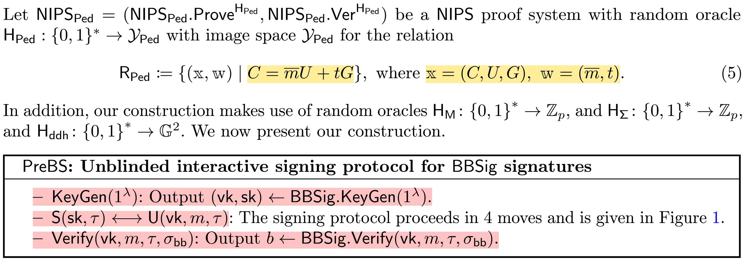
PreBS: Unblinded interactive signing protocol for BBSig signatures

Slide 17
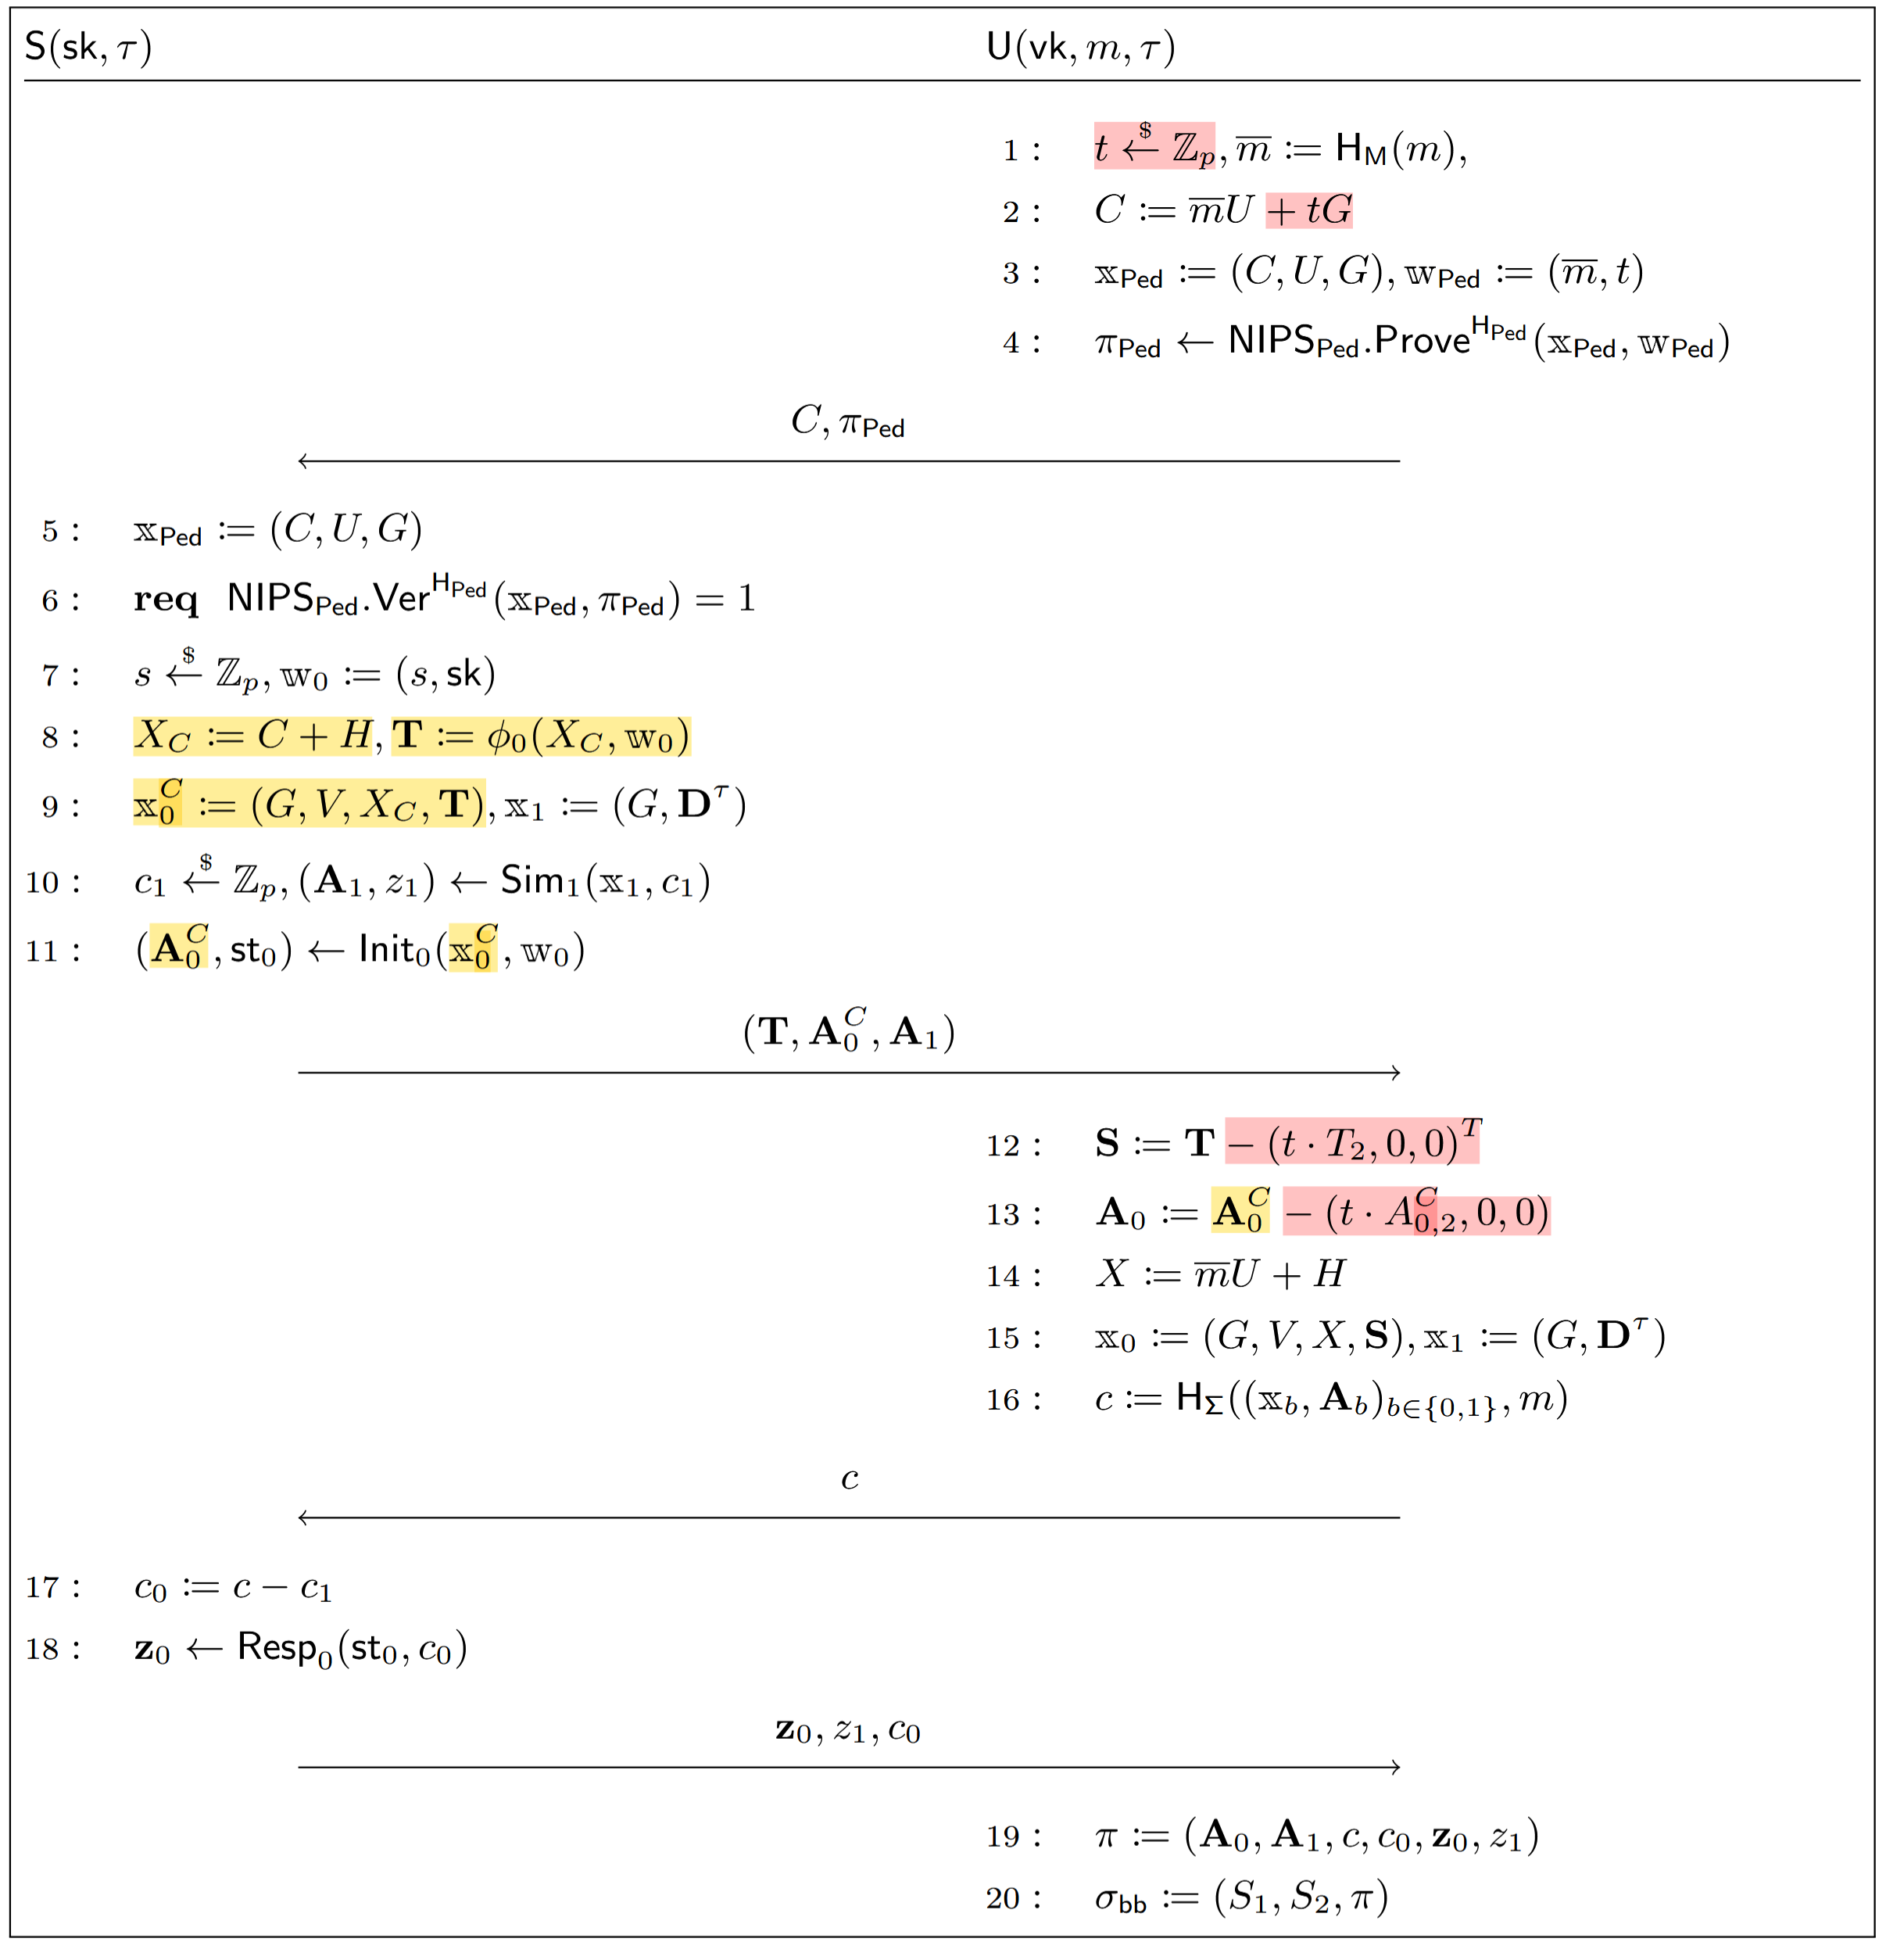
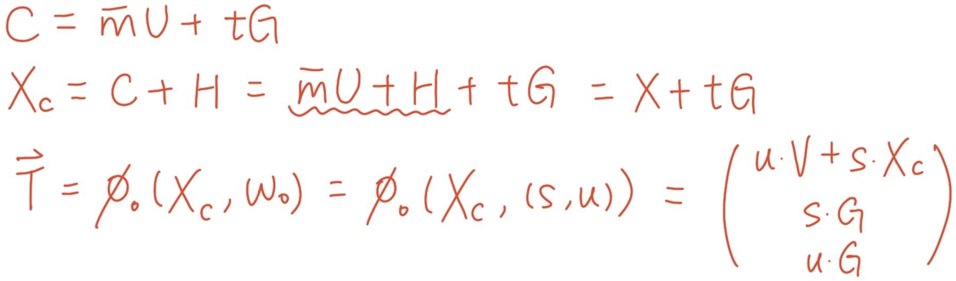
PreBS: Unblinded interactive signing protocol for BBSig signatures

Slide 18
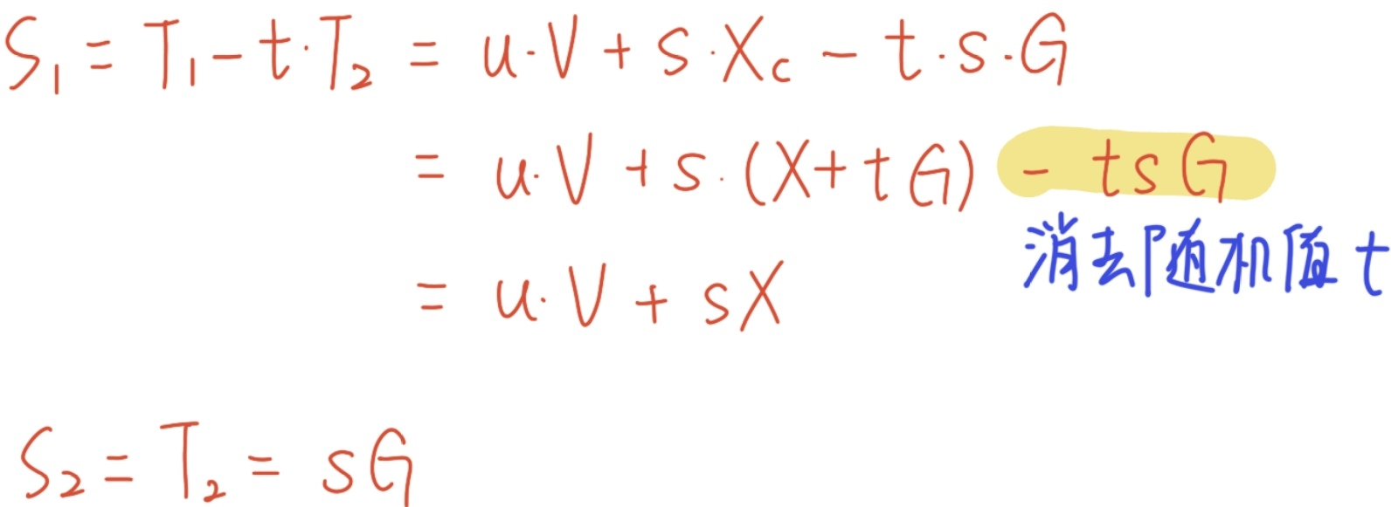
PreBS: Unblinded interactive signing protocol for BBSig signatures
Security Analysis——OMUF

Slide 19
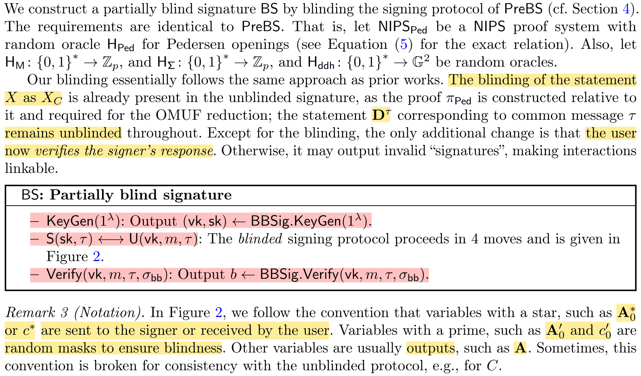
BS: Partially blind signature

Slide 20
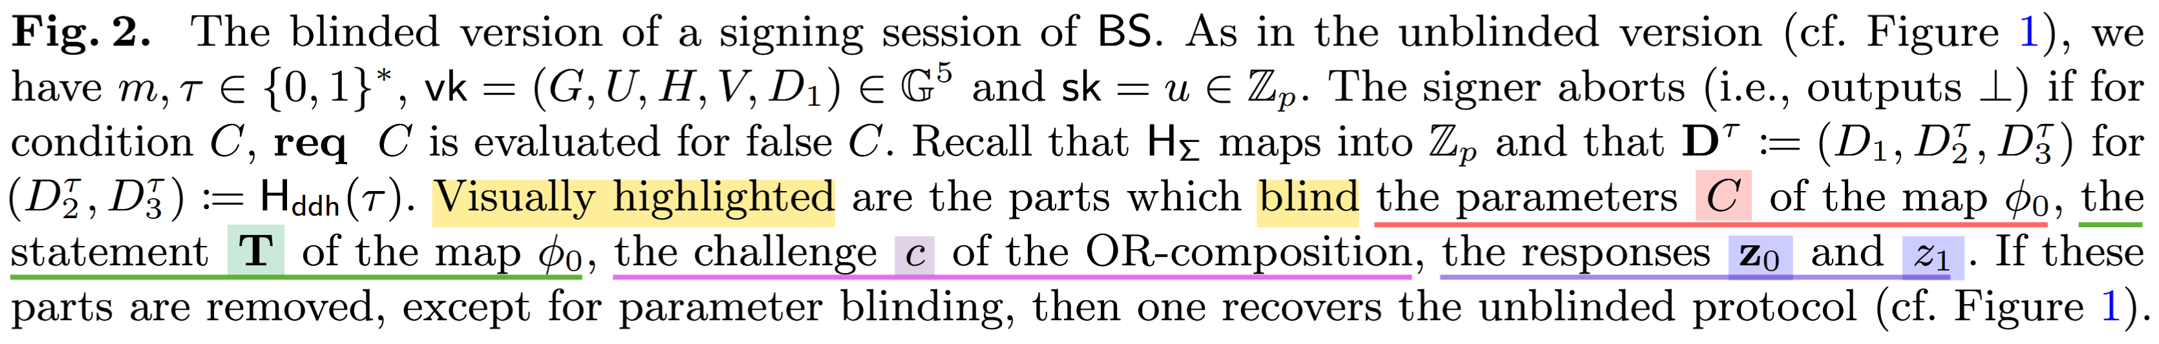
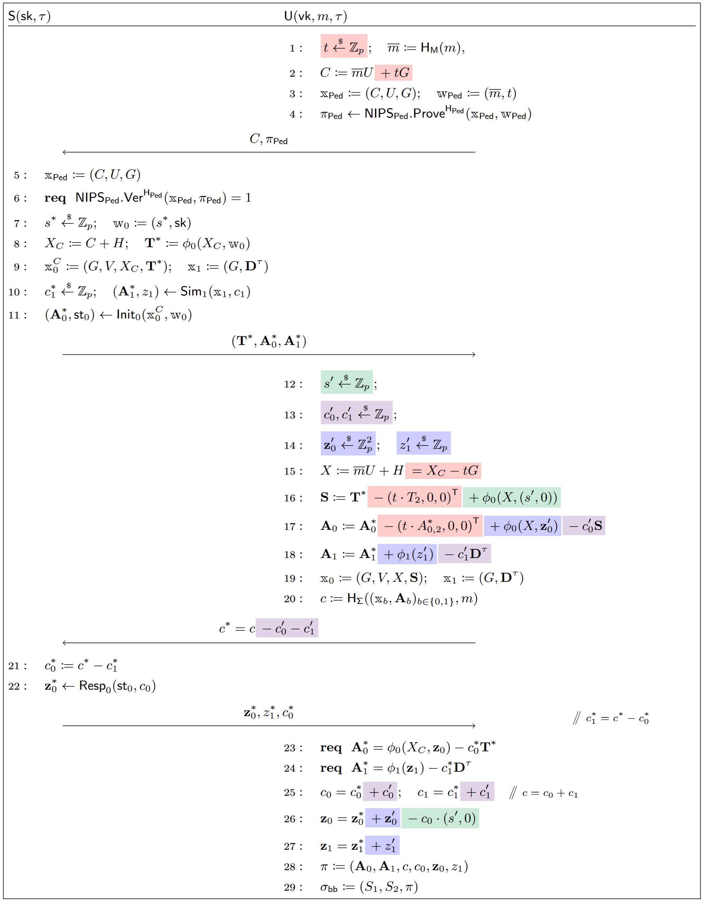
BS: Partially blind signature

Slide 21
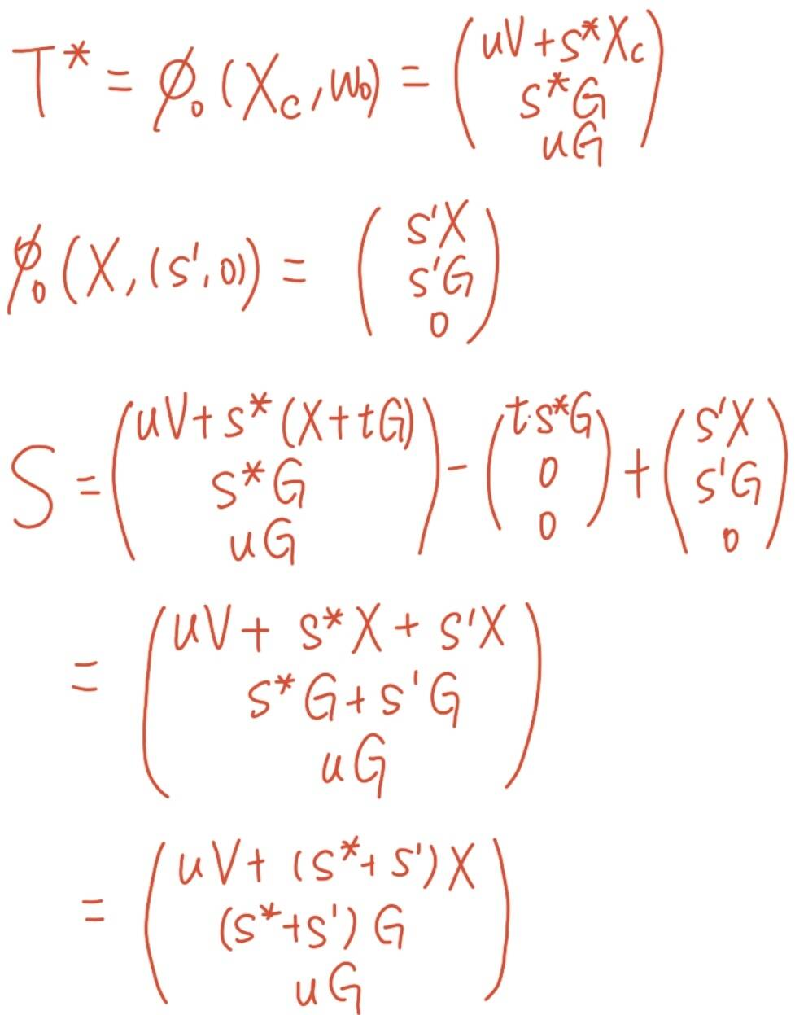
BS: Partially blind signature

Slide 22
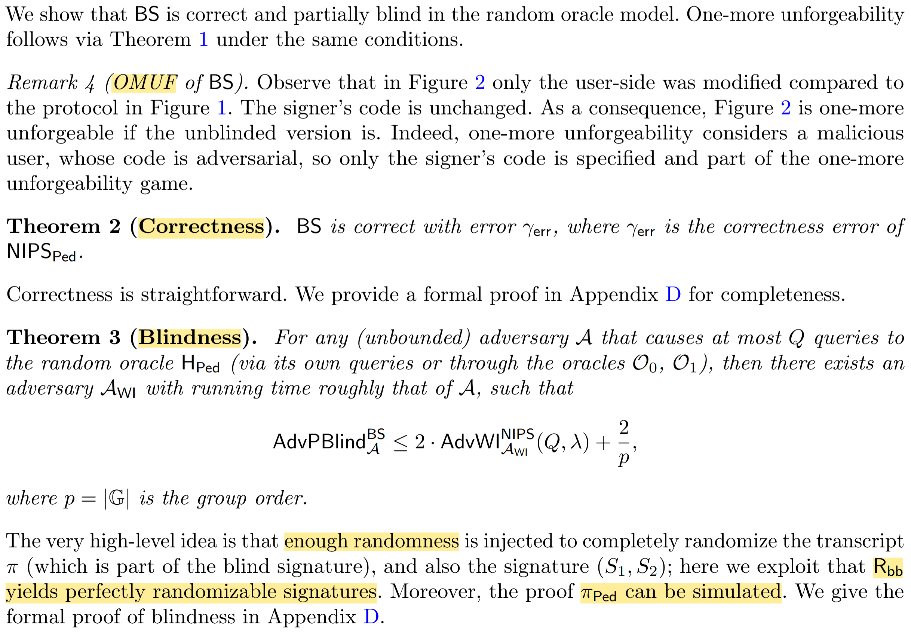
BS: Partially blind signature
Security Analysis

Slide 23
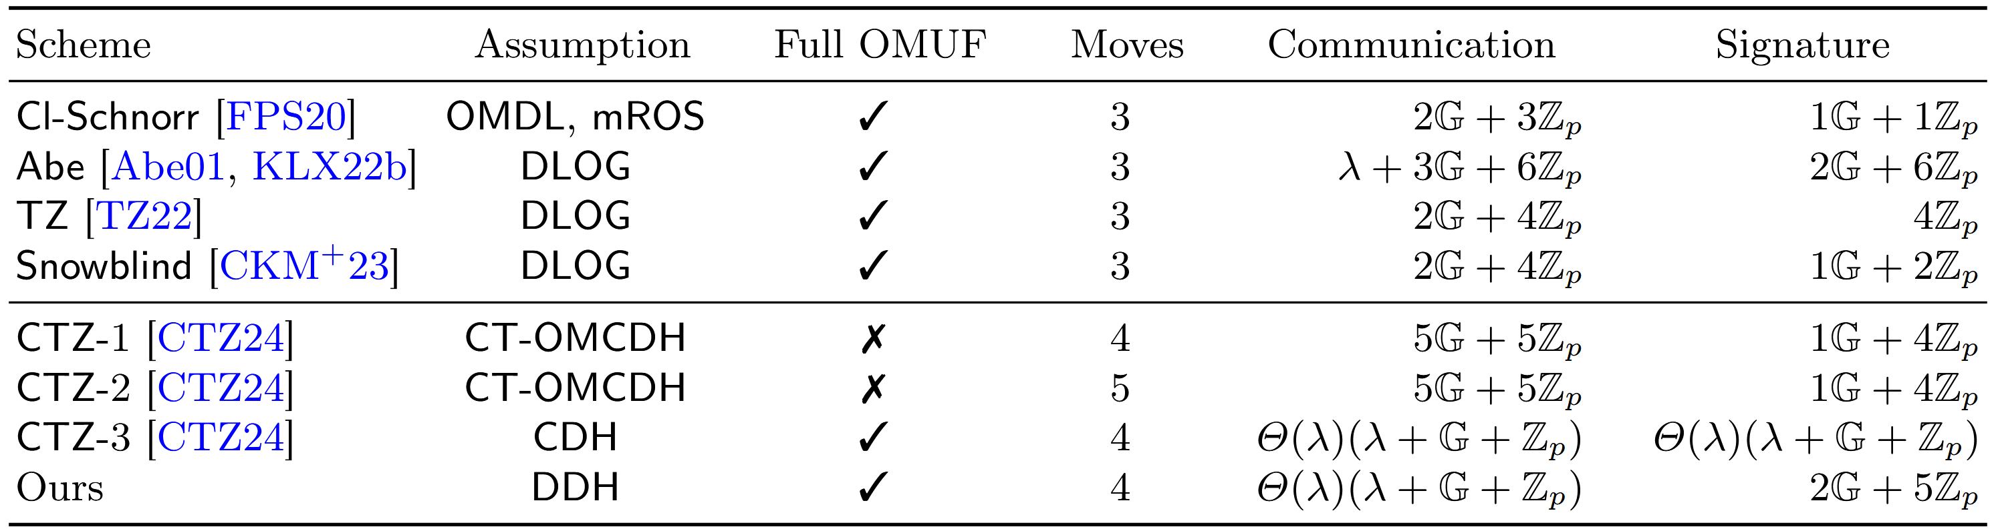
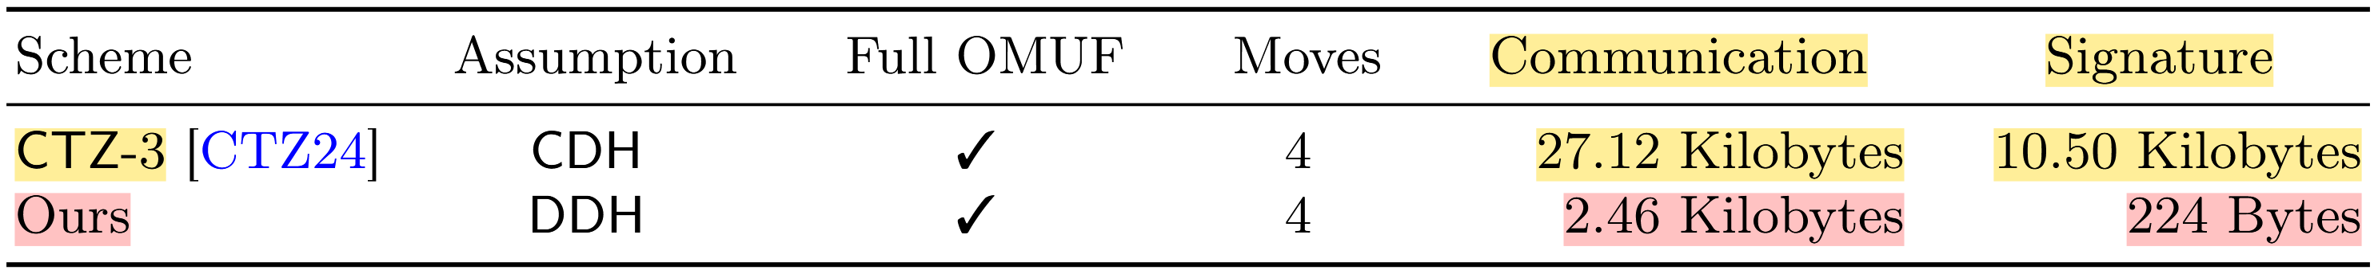
Comparison of efficiency
假设 λ = 128，群元素和域元素使用256位表示
通过Python脚本计算得出
Notes:
图1：所有构造都依赖于随机预言机模型，横线之上的方案还依赖于代数群模型。

Slide 24
Thanks!
Practical Blind Signatures in Pairing-Free Groups
ASIACRYPT 2024
2025.3.28

